Slide 1
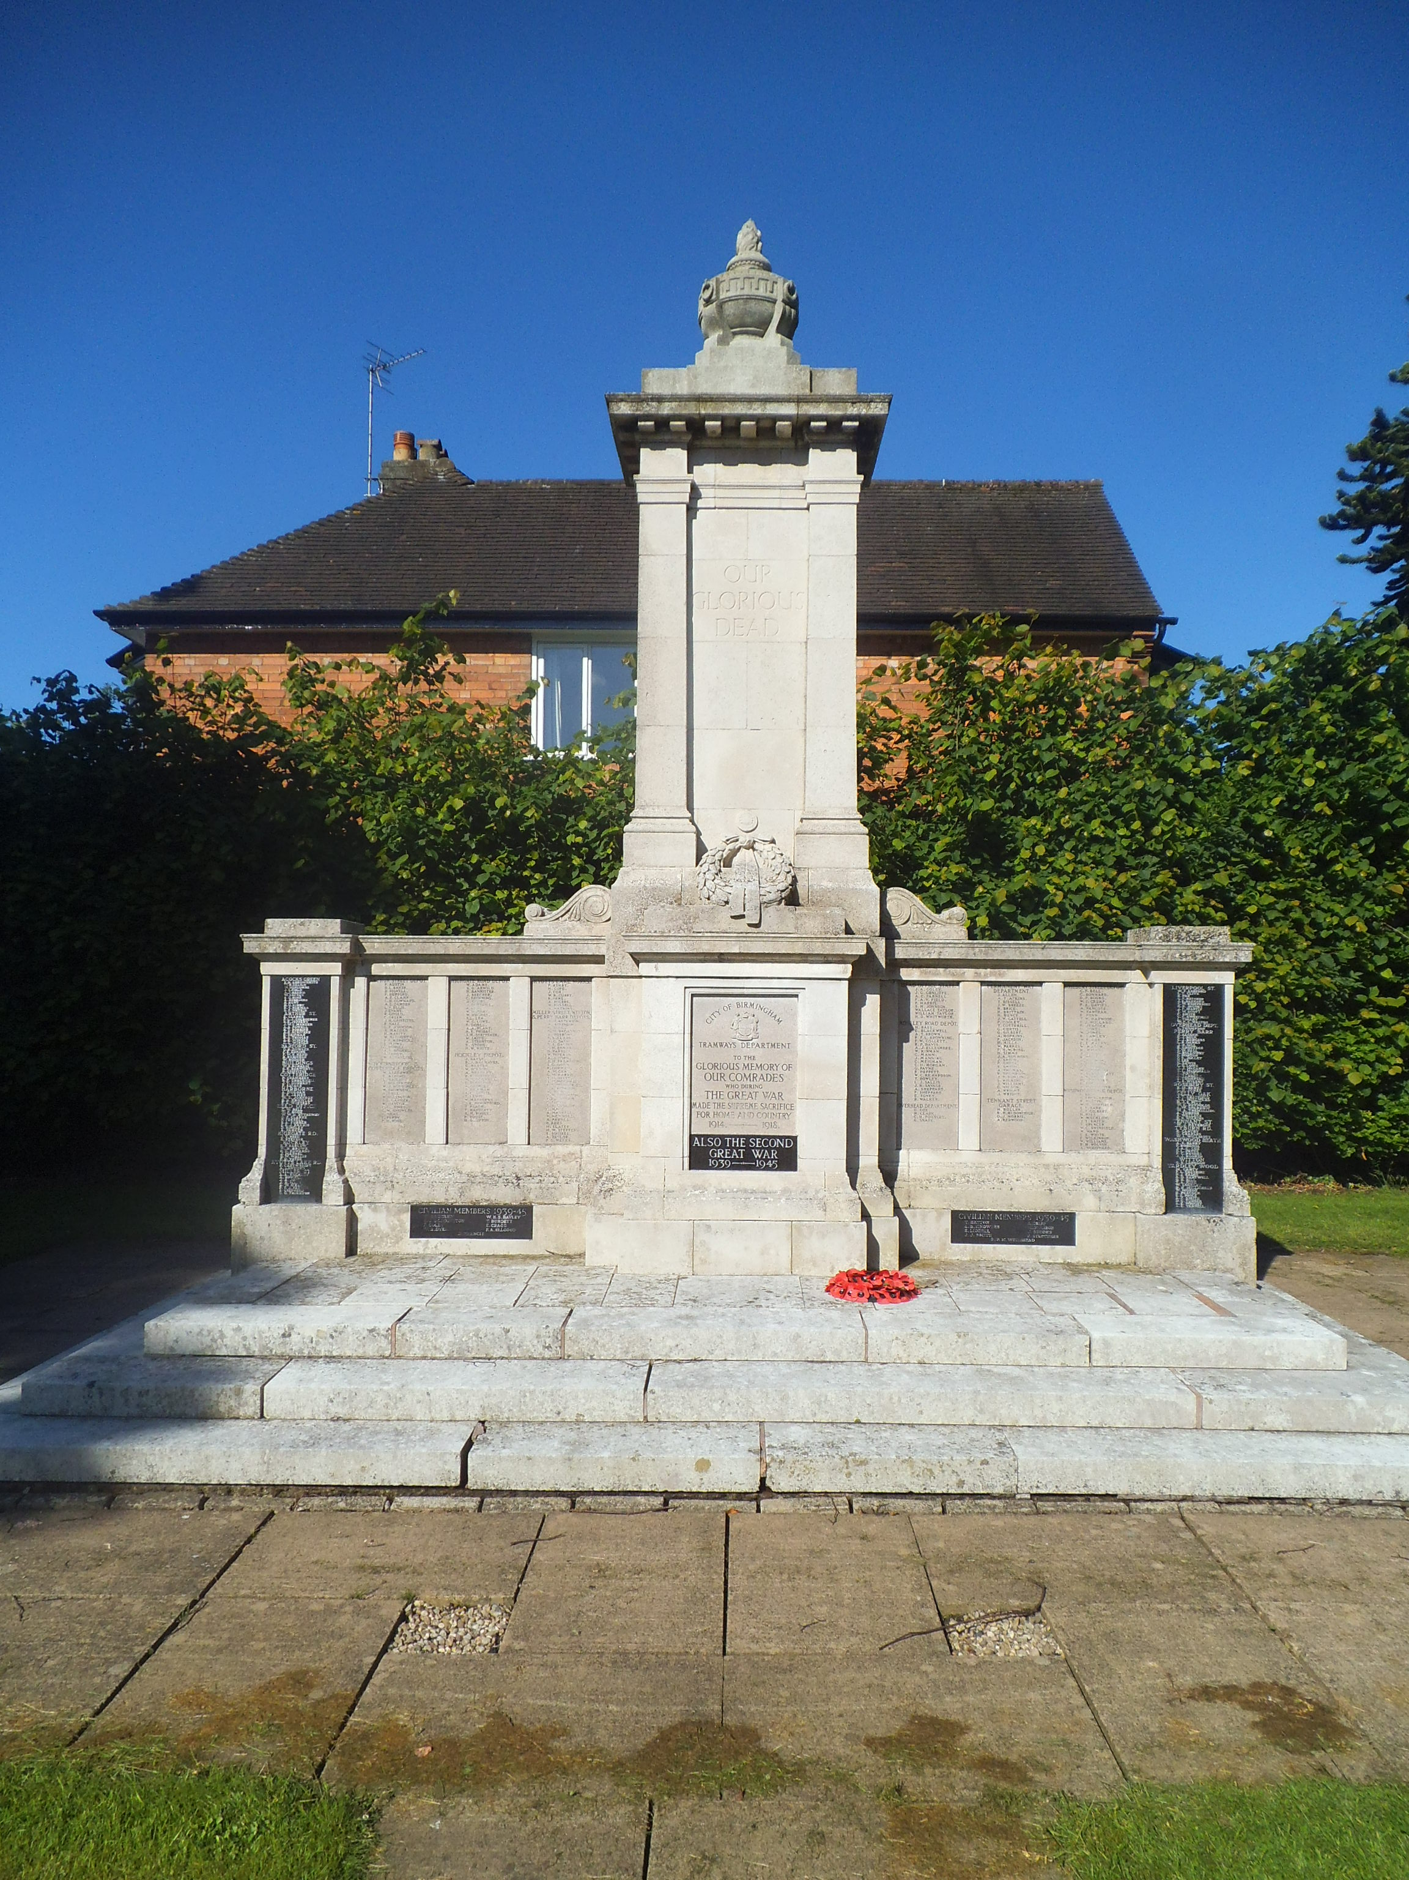
The Birmingham tramways war memorial
Douglas Smith MBE

Slide 2
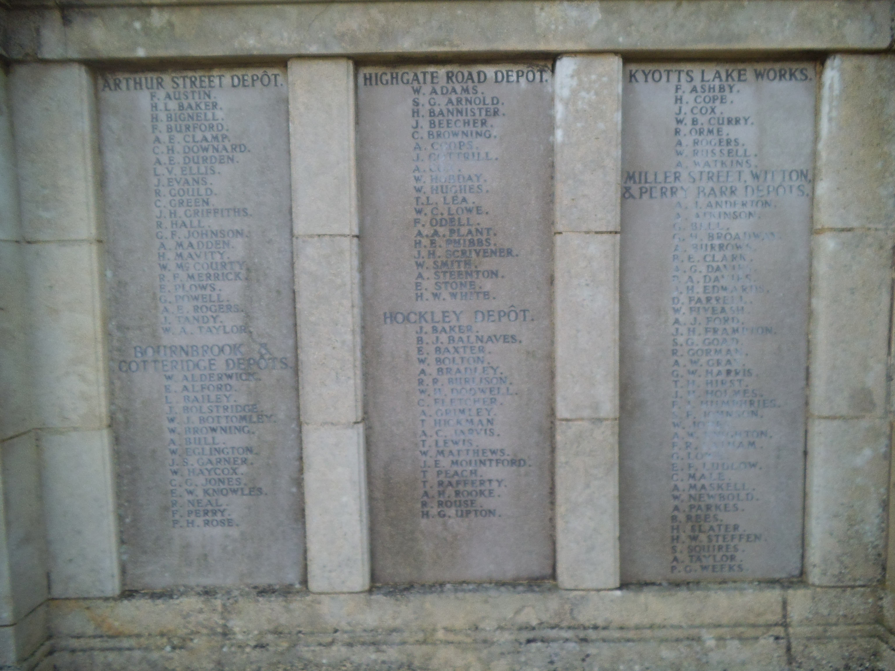
The names

Slide 3

A. J. Anderton

Slide 4
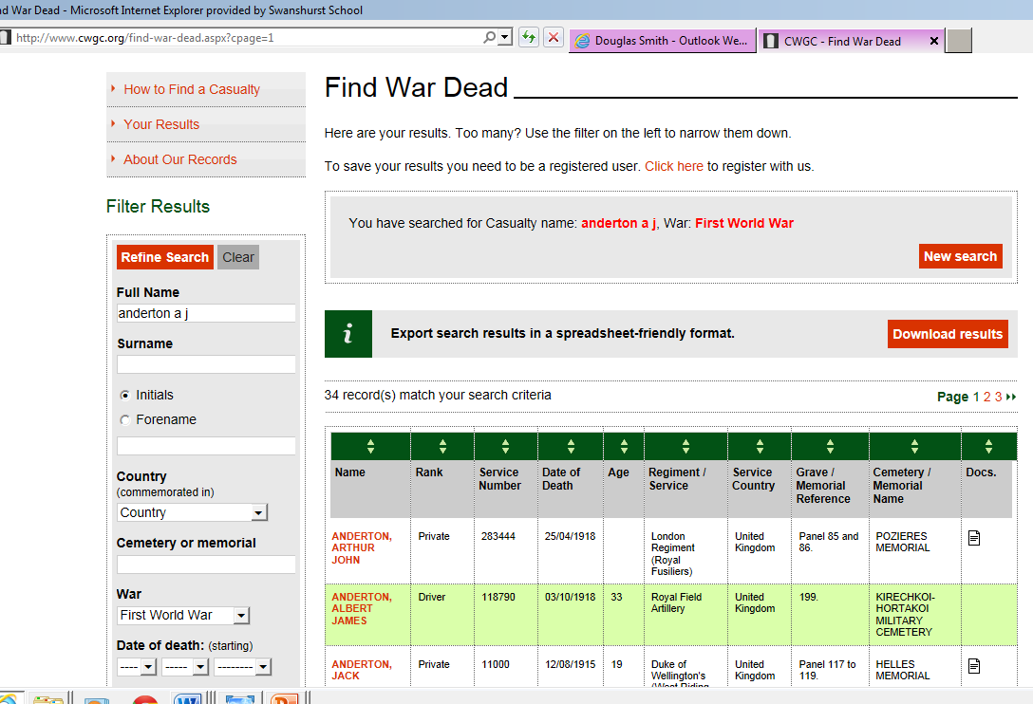
www.cwgc.org

Slide 5
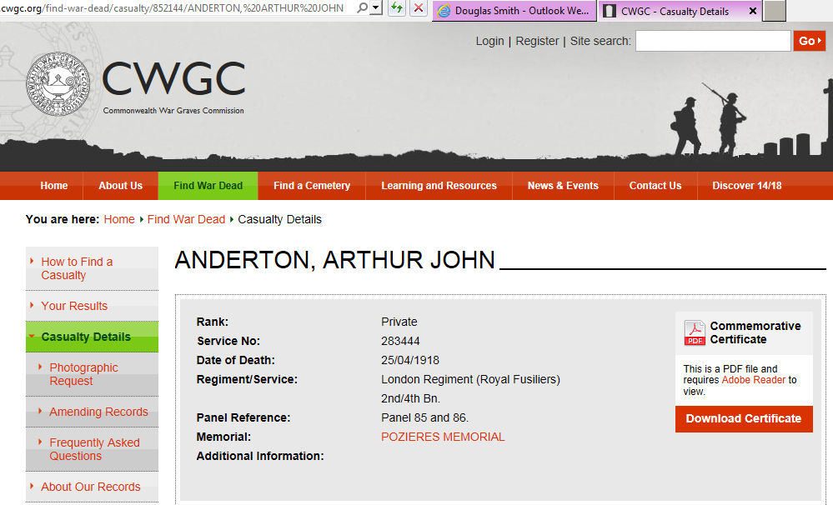

Slide 6
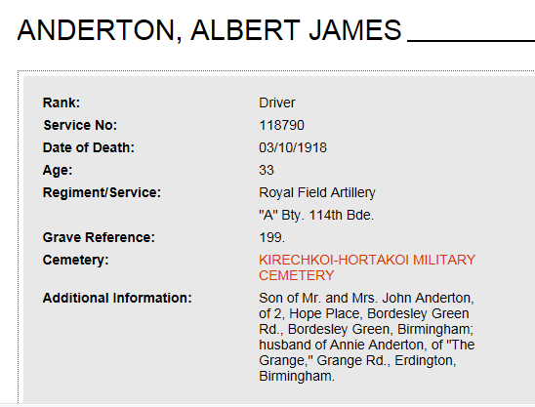

Slide 7
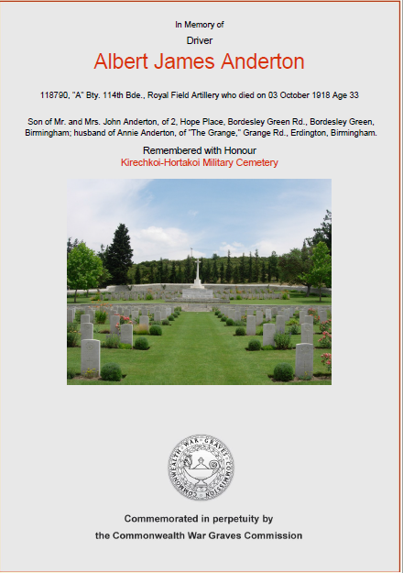

Slide 8
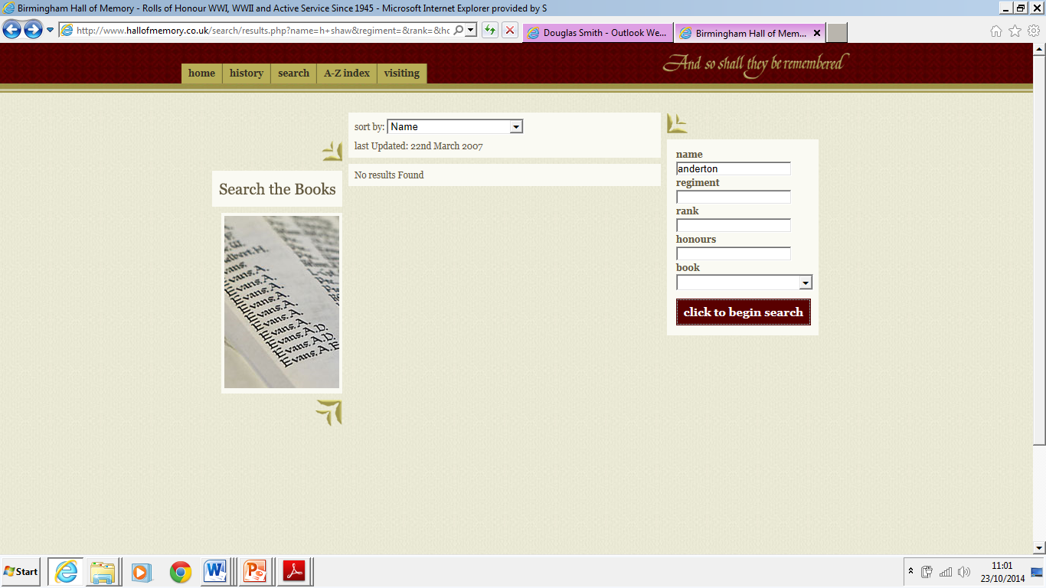
Birmingham Hall of Memory

Slide 9
Anderton, A. J., Driver., R.F.A., Book: First World War
Anderton, S. , Pte., R. War. Regt., Book: First World War
Anderton, F. , Pte., Livpl. Regt., Book: First World War
Anderton, W. C., Rflmn., Rifle Brig., Book: First World War

Slide 10
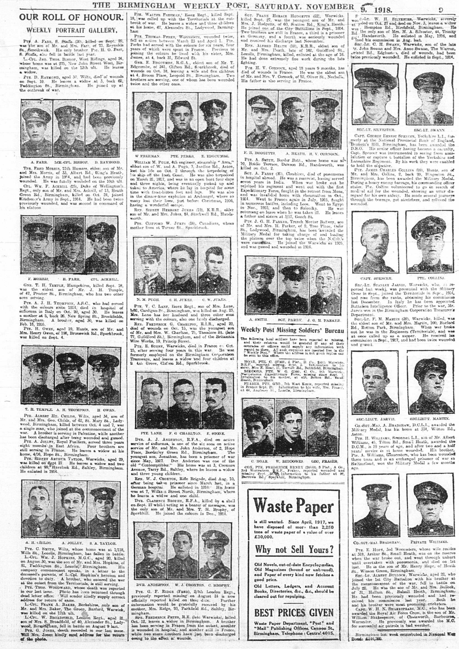
The Birmingham Weekly Post 9th November 1918
A.J. Anderton

Slide 11
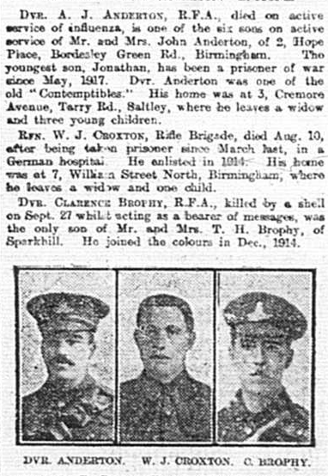

Slide 12
Driver Albert James Anderton
Driver Albert James Anderton – 118790 "A" Battery 114th Brigade Royal Field Artillery. He was one of six sons of Mr and Mrs John Anderton, of 2, Hope Place, Bordesley Green Road, Bordesley Green, Birmingham on active service. He was the husband of and husband of Annie Anderton, of 3 Cremore Avenue, Terry Road, Saltley, Birmingham and had three children. He worked for Birmingham Corporation Tramways at the Perry Barr and Witton Depots. He was one of the old ‘Contemptibles’. He was involved in the Salonika Campaign. He died of influenza on 3rd October 1918 aged 33 and is buried in the Kirechkoi-Hortakoi Military Cemetery.

Slide 13
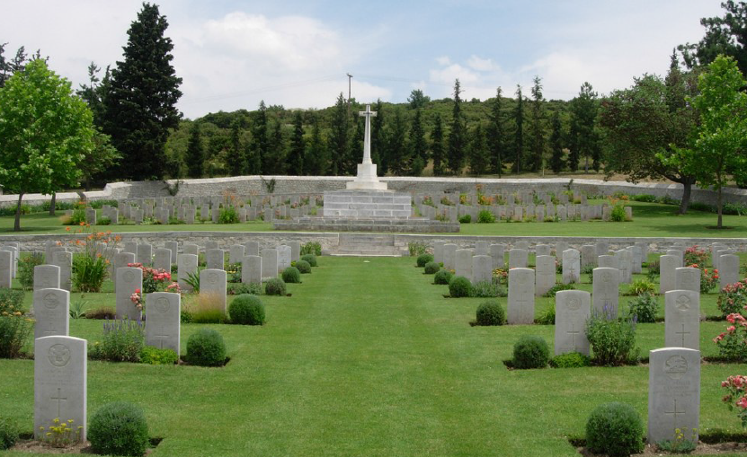
KIRECHKOI-HORTAKOI MILITARY CEMETERY
Historical Information
XVI Corps Headquarters were at Kirechkoi from January 1916, soon after the opening of the Salonika campaign, until the advance to the Struma in September 1916.
The cemetery was begun in March 1916, but it remained a very small one until September 1917, when the 60th, 65th and 66th General Hospitals came to the neighbourhood. In June, July and September 1918, other hospitals were brought to the high and healthy country beside the Salonika-Hortakoi road and in September 1918, the influenza epidemic began which raged for three months and filled three-quarters of the cemetery. The last burial took place in January 1919, but in 1937, 12 graves were brought into the cemetery from Salonika Protestant Cemetery where their permanent maintenance could not be assured.

Slide 14
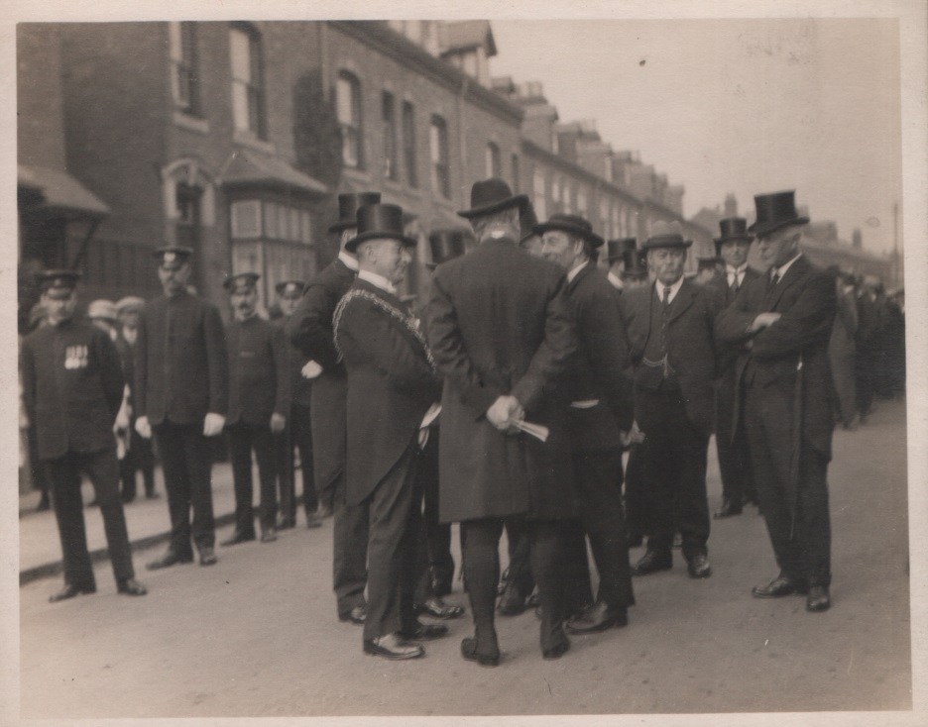
The procession from Kings Heath, Institute Road

Slide 15
Many thousands were brought to the spot, special cars being run from all parts of the city as well as a number of the departments omnibuses. The procession, which moved away at a was headed by the Tramways Band, was led by the Lord Bishop of Birmingham (Dr. Russel Wakefield), the Lord Mayor (Alderman David Daniels), the Town Clerk (Mr F H C Whitehurst), the Chairman (Councillor F. Smith), and members of the Tramways Committee, including Alderman Ellaway, James, Simpson, and Councillors Bishop, Chovill, Combridge,, Fryer, Lee and Jones, the General Manager (Mr Alfred Baker), Assistant General Manager (Mr J. McDonnell), Chief Engineer (Mr A. C. Baker), Traffic Superintendent (Mr L. Johnson) and other officials. Then followed about 2,000 tramwaysmen in uniform, wearing their war medals and ribbons.

Slide 16
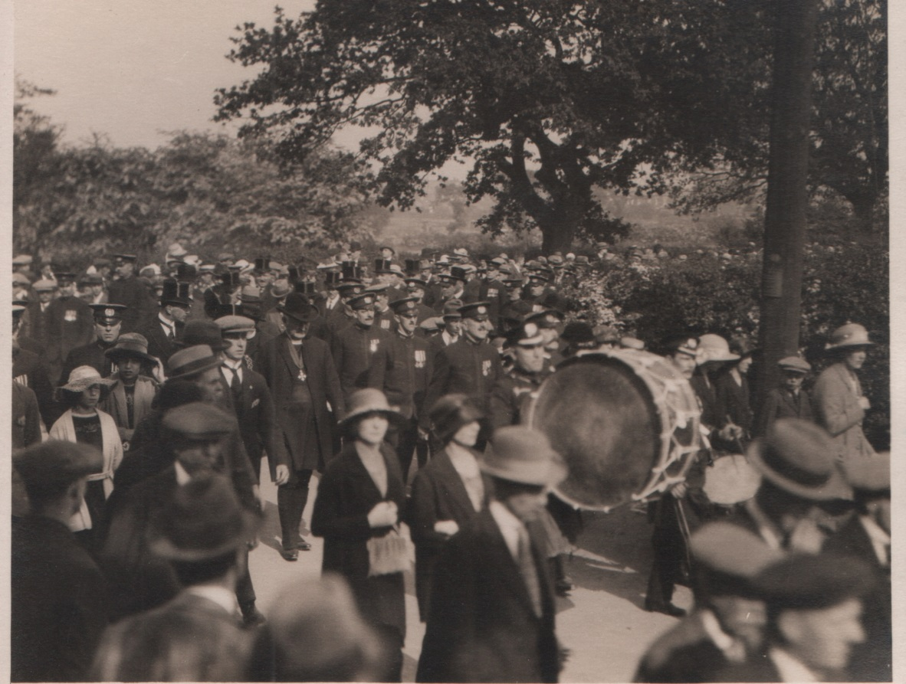

Slide 17
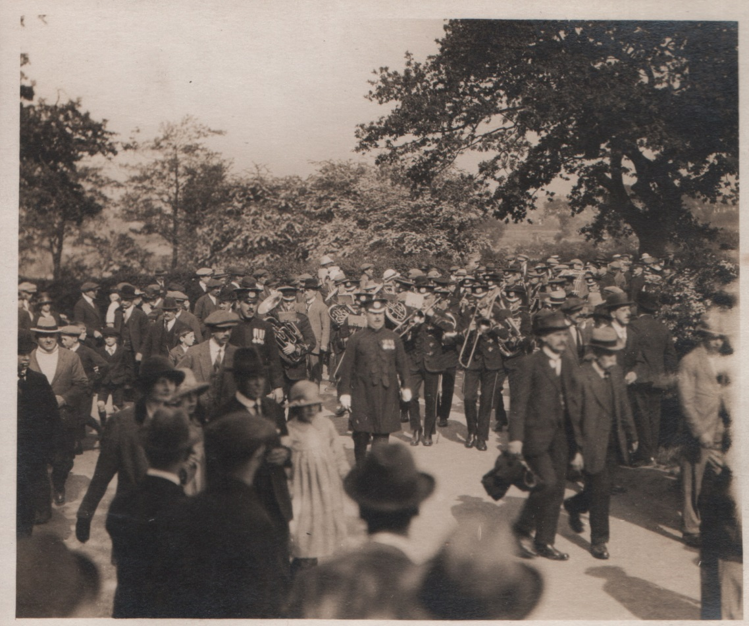

Slide 18
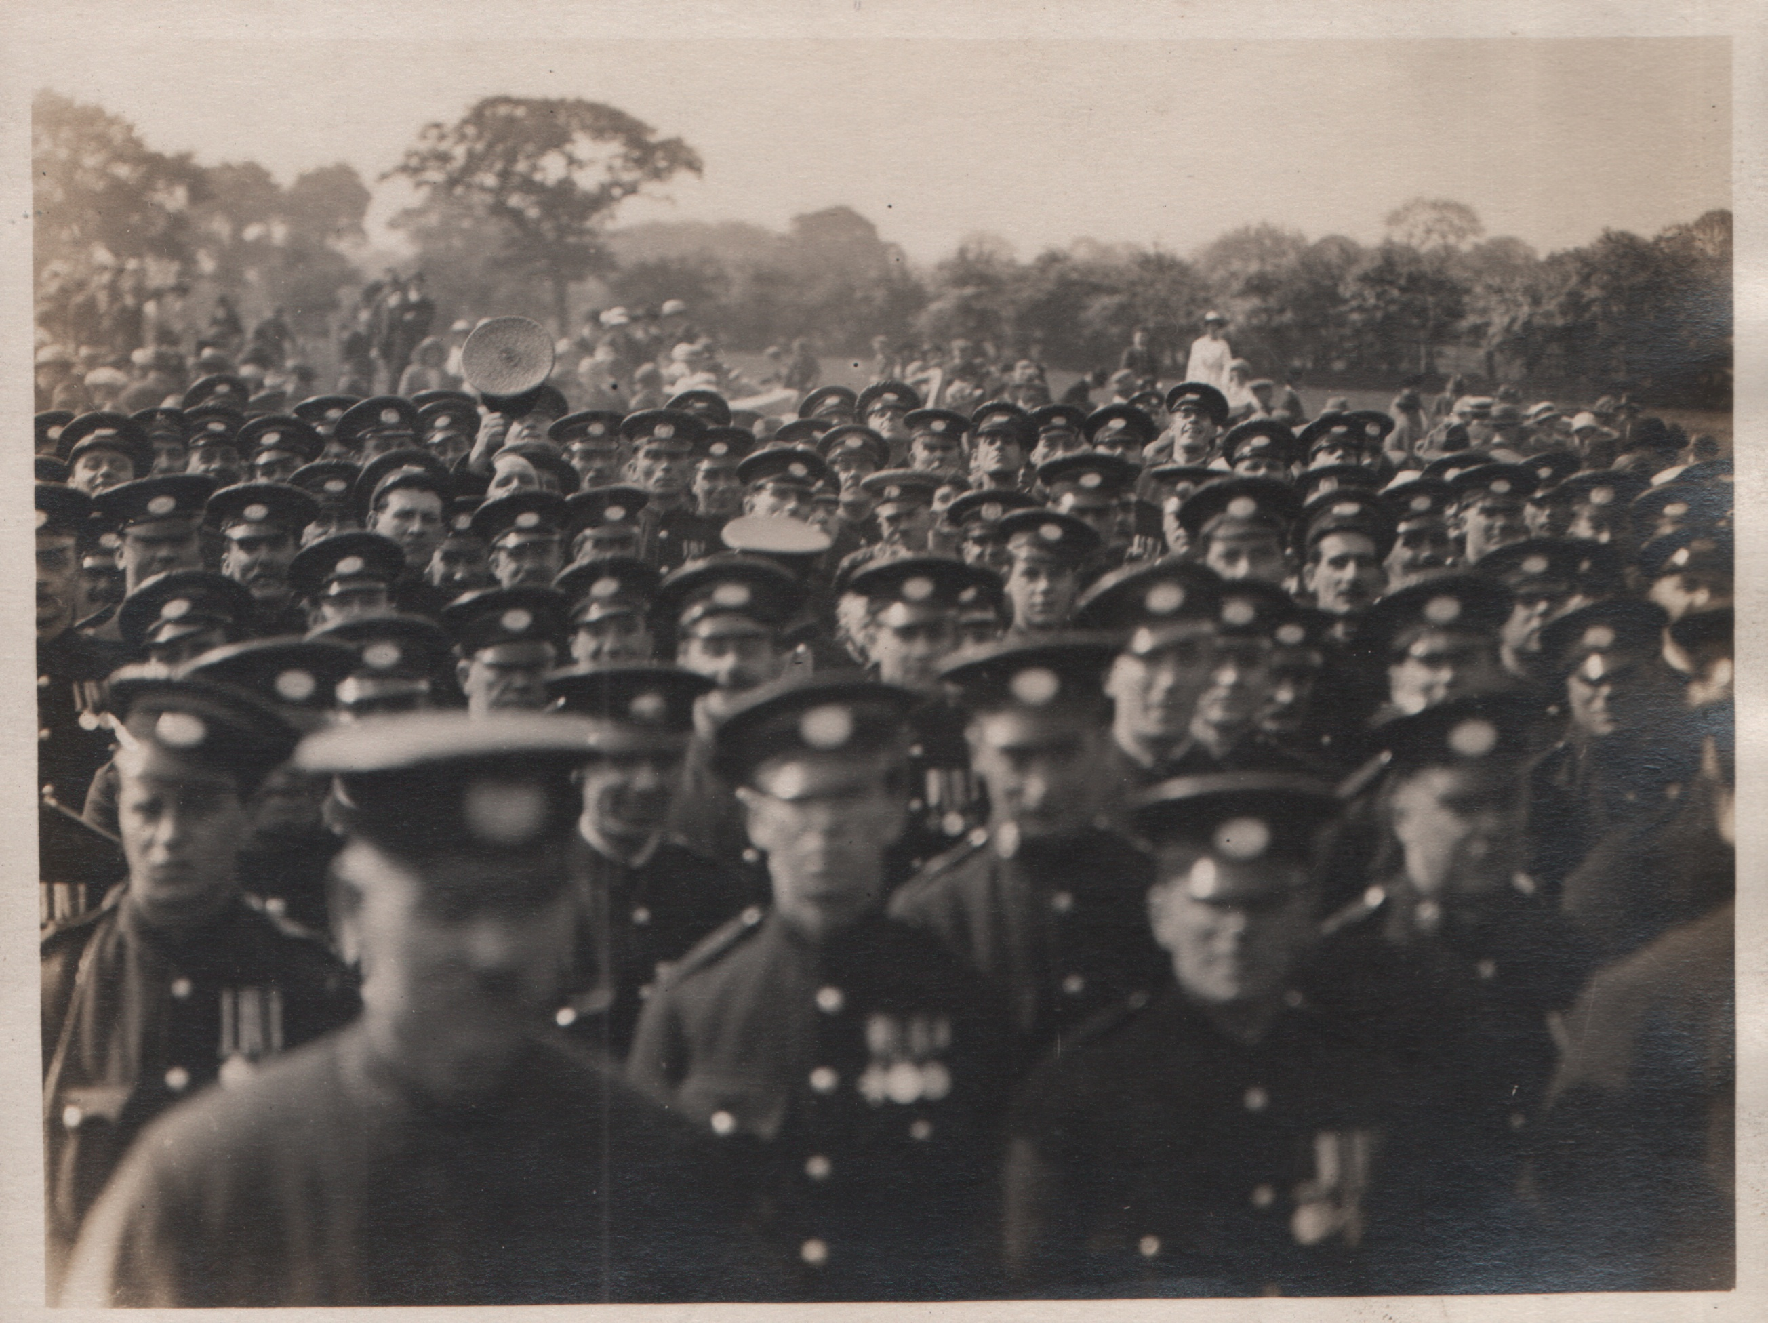

Slide 19
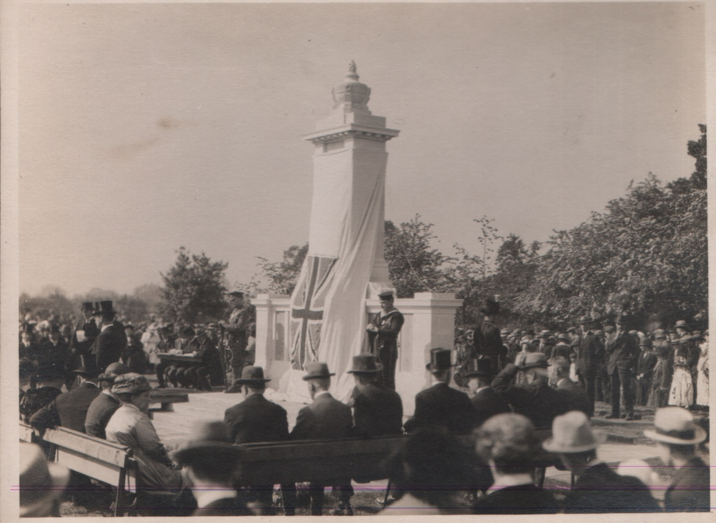

Slide 20
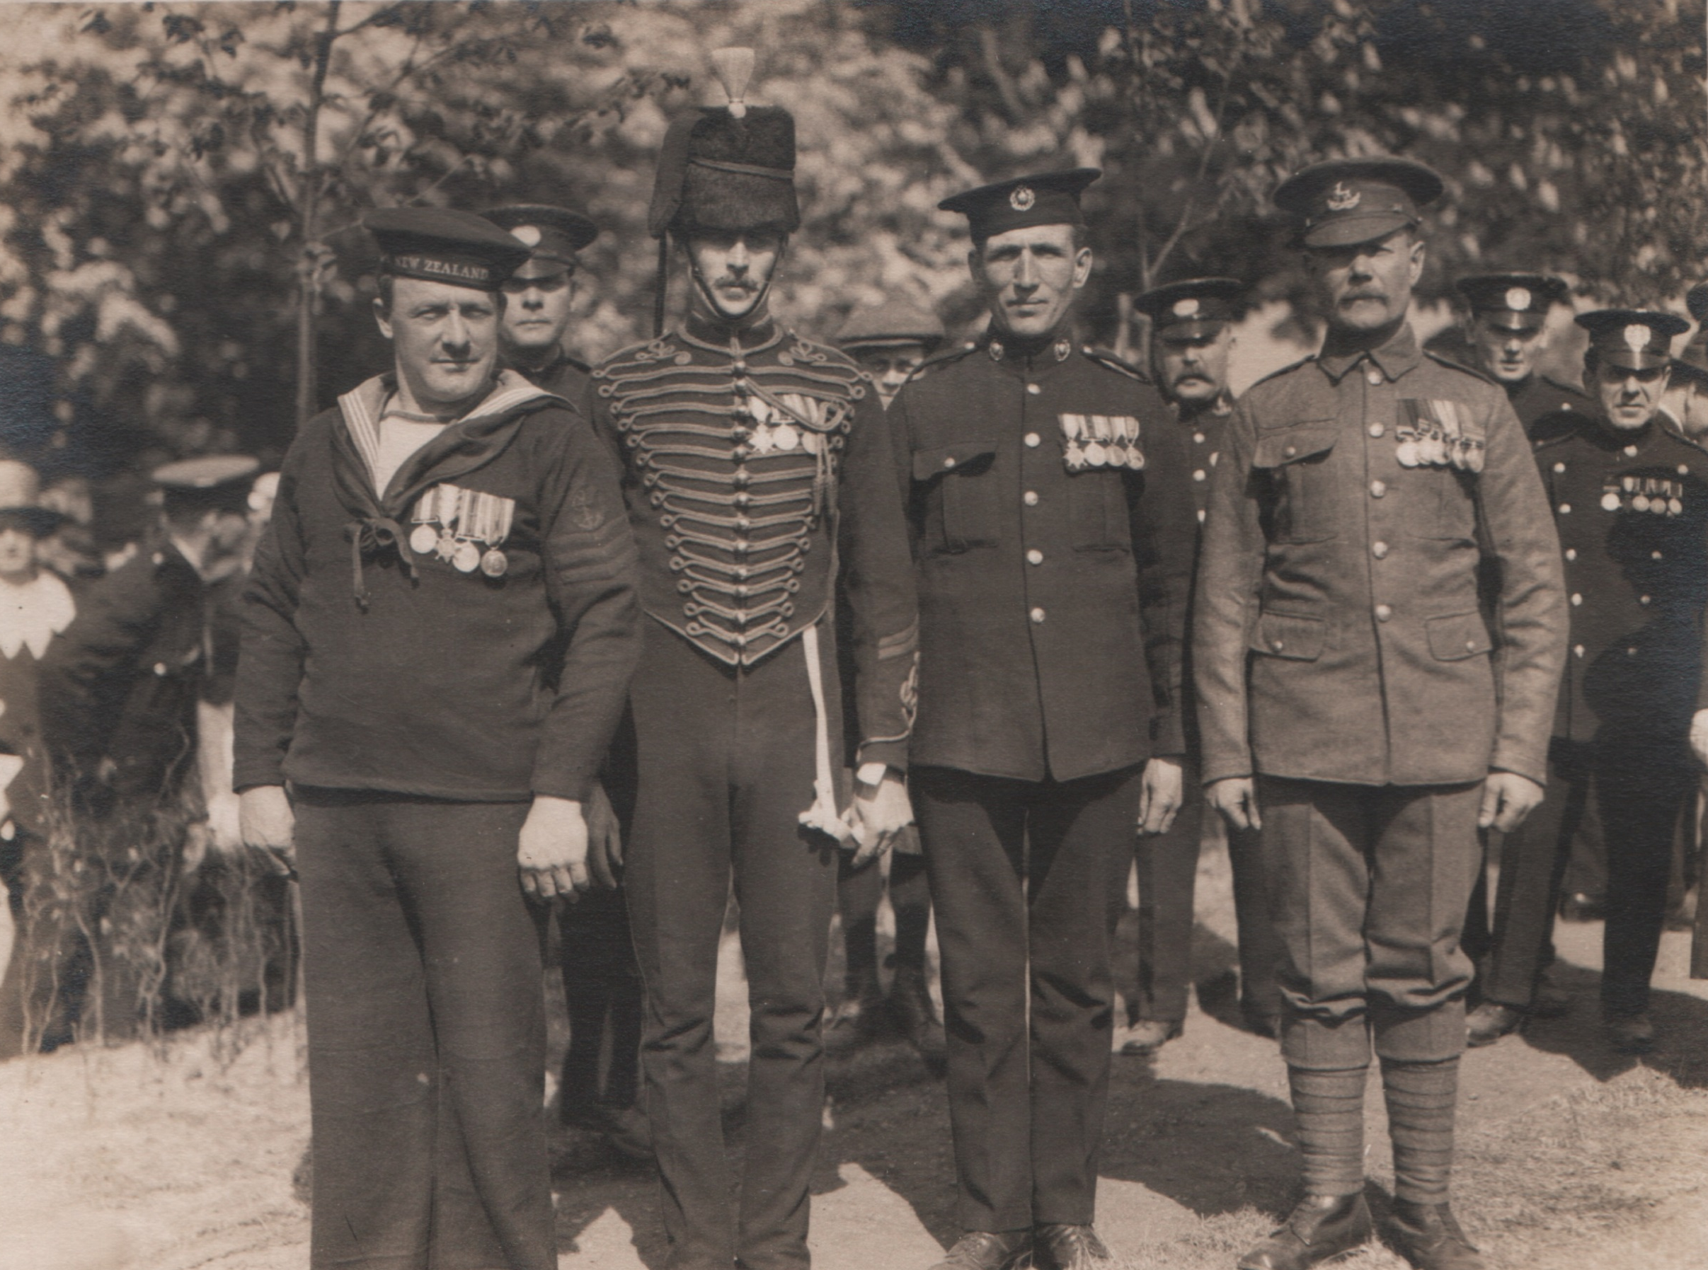
One was an infantryman in Khaki, and wearing eight medals, another was a sailor, another a marine, and the fourth a cavalryman, in the picturesque dress uniform of one of the mounted regiments.

Slide 21
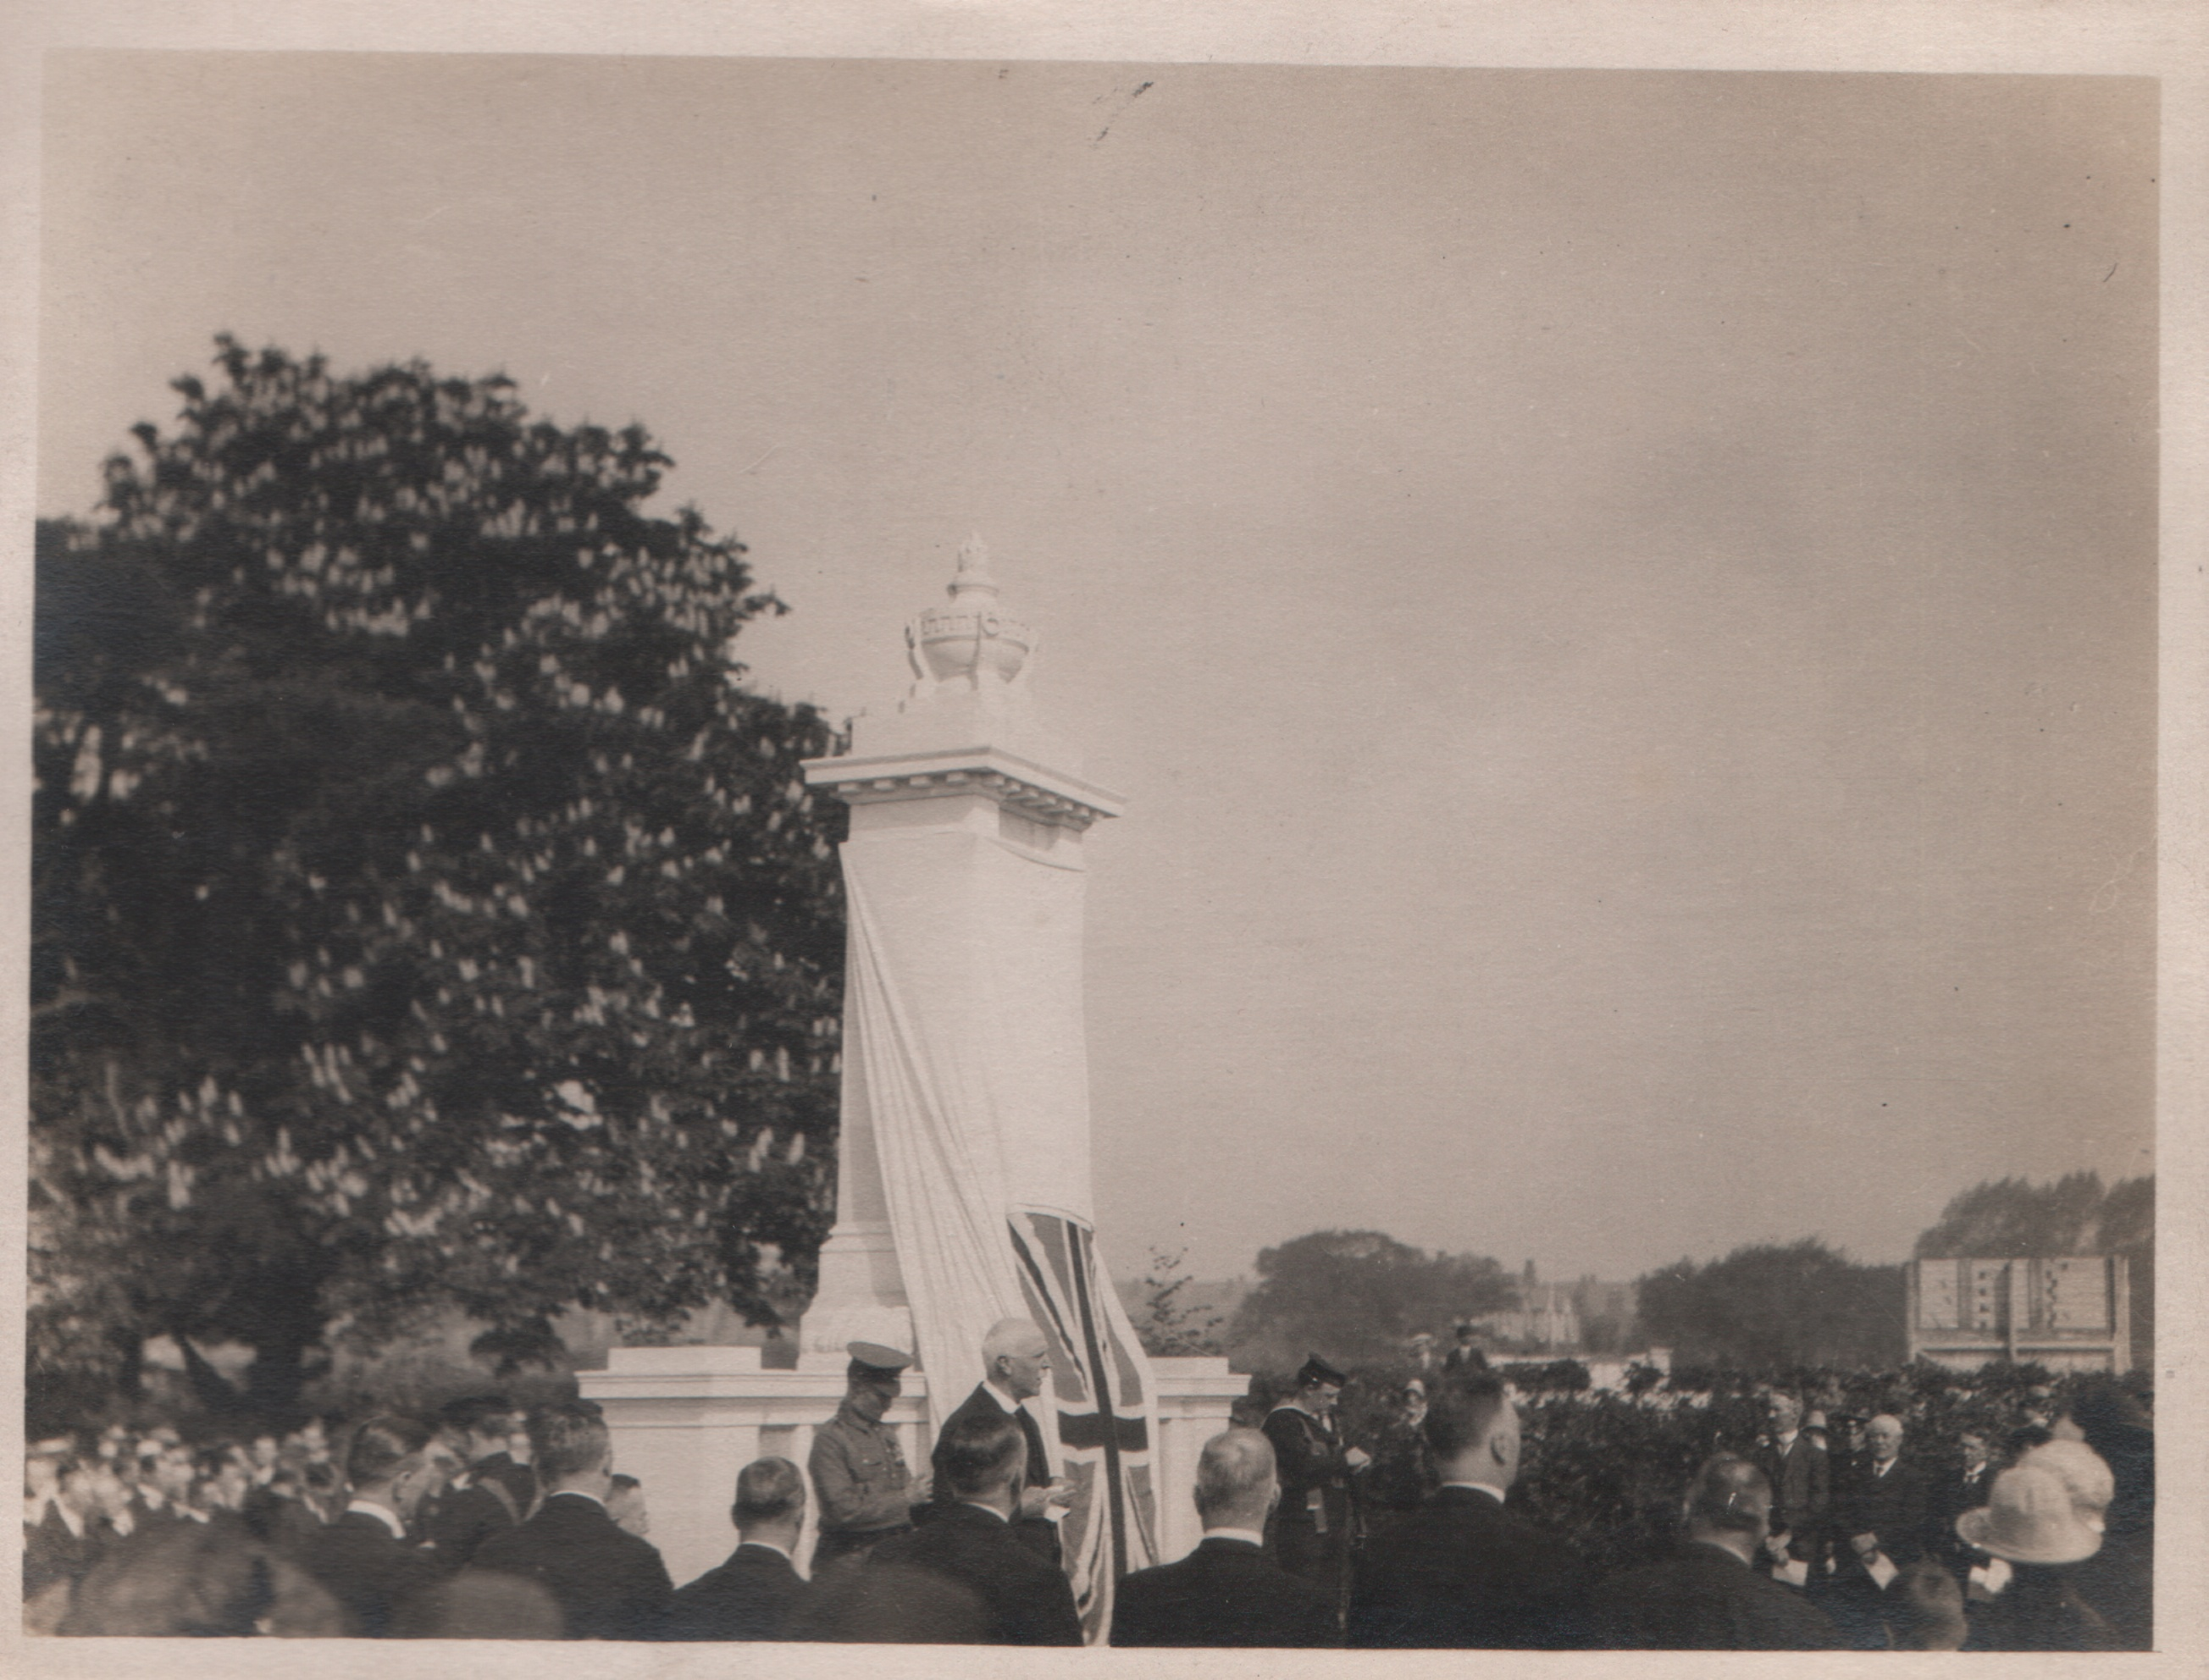
Arthur Baker, General Manager, Tramways Department

Slide 22
‘On the outbreak of war in 1914, no body of men answered the call of King and Country with greater enthusiasm, than the Birmingham tramways men. Before the end of August, 600 men, or 20% of the total employees of the department had joined up. So keen were the men to do their duty that on one memorable Sunday morning no fewer than 300 march en bloc to Witton Barracks, and enlisted in the 8th Warwickshire Regiment: these men formed a double company in that regiment and provided their own non-commissioned officers. Throughout the course of the War, the tramways department supplied 1,800 men to the forces. That they acquitted themselves nobly in all fields would it be understood when it was mentioned that a large number of honours and distinctions were gained, including 2 Military Crosses, 20 Military Medals, 11 Distinguished Conduct Medals, 1 Italian Bronze Medal, and 1 Serbian Medal, the Karageorge, which I understand, is the highest honour bestowed by the Serbian Government.’

Slide 23
‘… Unfortunately, a large number were called upon to make the supreme sacrifice. 236 laid down their lives, and it is in their honour that we are gathered here today. The whole cost of the memorial has been contributed by the men themselves, without any assistance whatever, either from the Corporation or the Tramways Committee.’

Slide 24
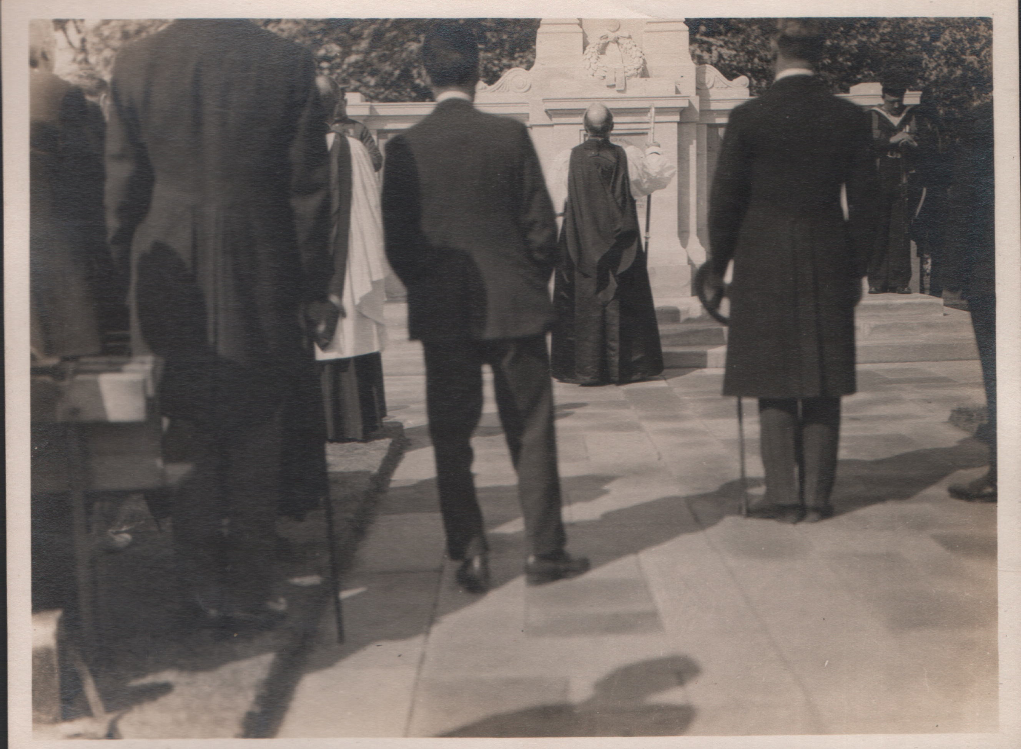
The Bishop of Birmingham: ‘To the glory of God, and in the memory of the brave men connected with the Tramways Department of the City, who fell in the service of God and Country, I dedicate this memorial.’

Slide 25
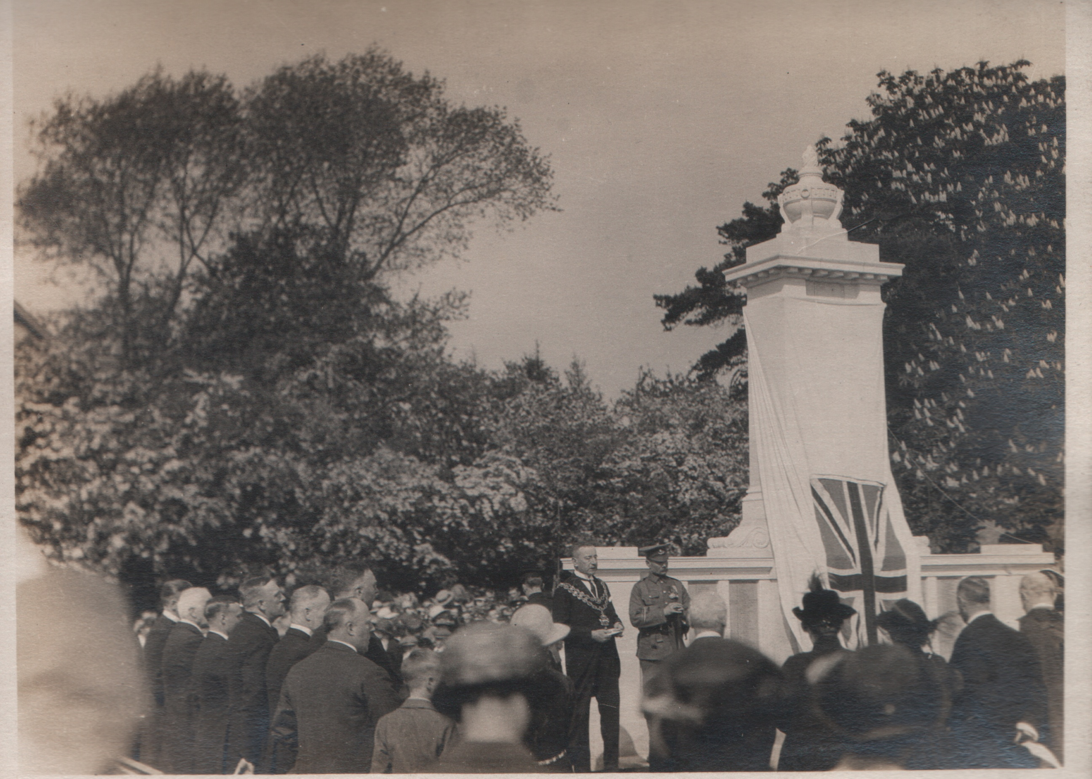

Slide 26
‘We, in Birmingham, are proud of the men of the tramways department, who took their parts in the Great War. The Corporation of Birmingham sent from its staff 6,500, and they did their duty nobly, while 700 of them failed to return. I believed that this memorial will be considered worthy of the Department. It is but a symbol. It represents our appreciation of the gallant part played by the men who, unfortunately, we shall see no more, and it is intended to keep green the memory of those who sacrificed all, that others might live. I venture to think there is also a call to duty to those who survive. That duty is to the living, to help those who require and deserve our assistance; and that while we shall never forget the past, bitter though it has been, we shall look hopefully to the future, and each strive to do his part on behalf of his fellow men, so that each one shall deserve to be called a son of our great empire’

Slide 27
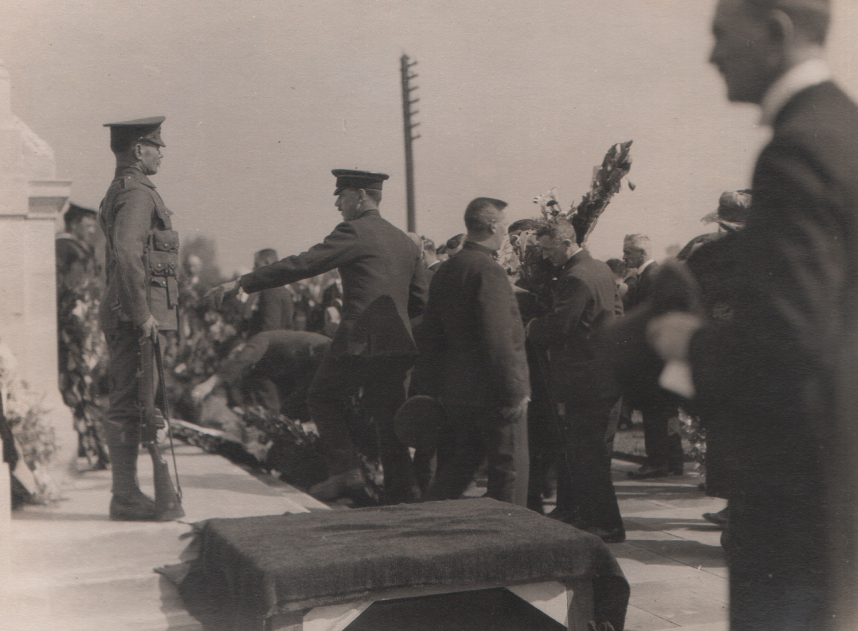
The ceremony over, those present then passed the Cenotaph, and placed their floral tributes at the foot of the memorial. There were many beautiful wreathes from each Depot, ex-conducturesses, and late auxiliary drivers, as well as many from the relatives.’

Slide 28
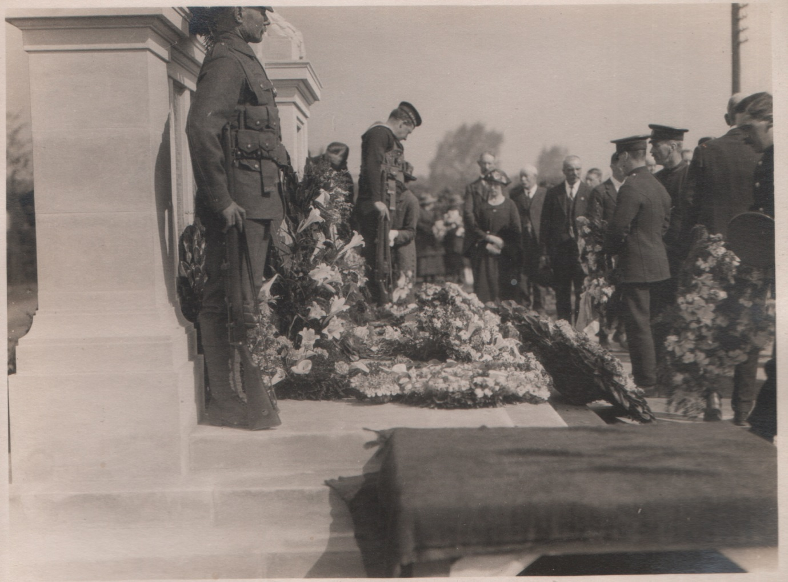

Slide 29
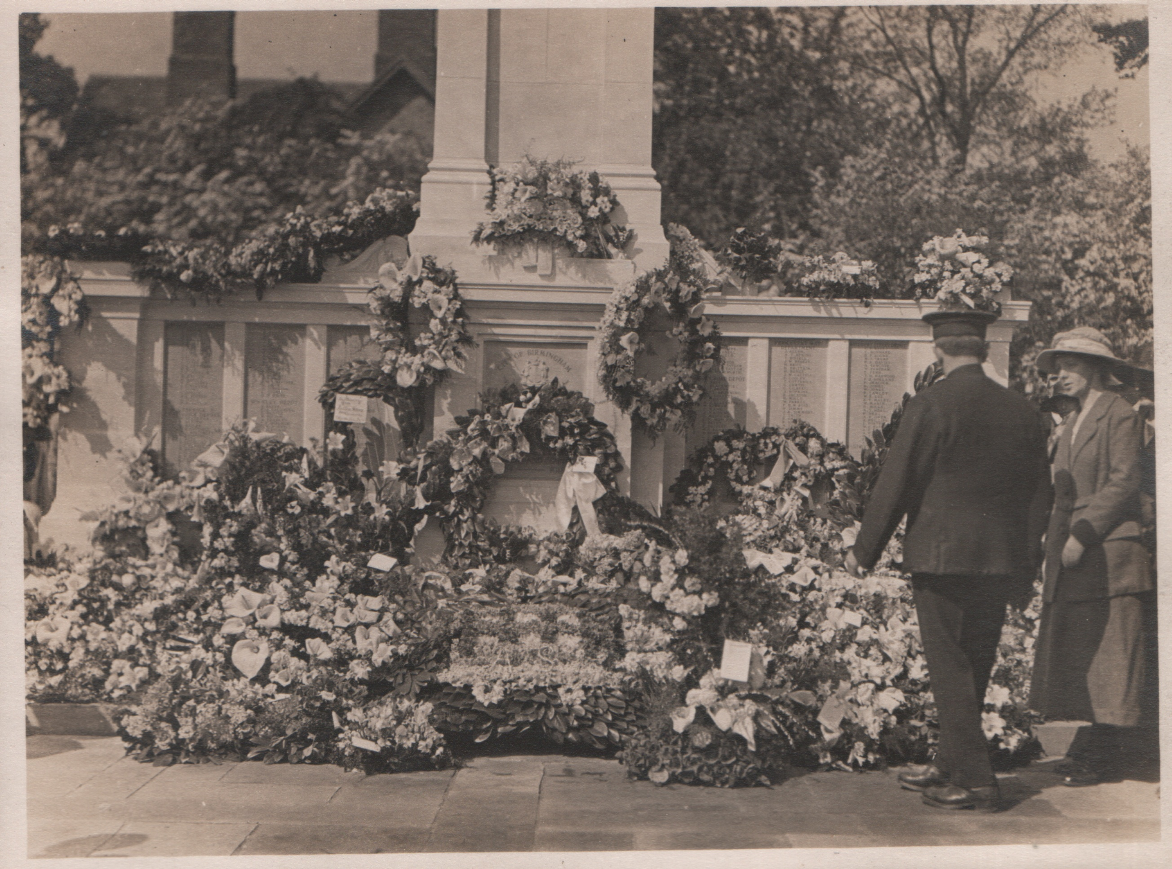
‘By the time everyone had passed by, the memorial was a mass of flowers.’

Slide 30
Rifleman Henry Townsend – 2714 1st Battalion King's Royal Rifle Corps. He was born in Birmingham and was the son of Alfred and Ellen Townsend and the husband Violet Louise Townsend, of 26, Water St., Rhyl, Flintshire. His home was 115 Monument Road, Ladywood, Birmingham. He went all through the South African War and was sent there to Egypt where he finished his service in 1906. When he came home he worked for Birmingham Corporation Tramways at the Roseberry Street Depot and continued with them till he re-joined the colours on 5th August 1914. He was sent to Winchester and from there he was sent to France where he was wounded in the Battle of Mons. He died in a French Hospital aged 34 on 16th September 1914 leaving a widow and three young children, the oldest barely five. He is buried in the Vailly British Cemetery.

Slide 32
Private Robert Neal – 8923 1st Battalion Royal Warwickshire Regiment. He lived at 100 Ellen Street. He was a reservist and was a motorman on the Ladywood route of the Birmingham Tramways working at the Roseberry Street Depot. First Battle of Ypres 19th October to 22nd November 1914 (The Battle of Messines 12 October – 2 November 1914) He died from his wounds on died on 27th October 1914 and is buried in the Ypres Town Cemetery

Slide 34
The Battle of Gheluvelt 29th to 31st October. Private John Edward Porter – 10438 2nd Battalion Worcestershire Regiment. He was the husband of Mrs. Ellen Williams (formerly Porter), of 15, Brighton Place, Abbey St., Hockley, Birmingham. He lived at 7 Musgrave Road, Winson Green. He worked as a conductor on the Dudley Road route. He died aged 25 on 31st October 1914 and is remembered on the Ypres (Menin Gate) Memorial

Slide 35
Rifleman Charles Thomas Gilbert – 7655 2nd Battalion King's Royal Rifle Corps. He was the son of Charles Albert and Sarah Ellen Gilbert, of 25, Heneage Street, Ashted, Birmingham. He joined the South Staffordshire Regiment in Birmingham in May 1906 at the age of 17 years and 9 months. He was 5 feet 5 ½ inches tall with a small scar on the right side of his neck. He was a regular solder till November 1913 after 7 years’ service and was placed on the Reserve. He worked as a conductor on the Washwood Heath route. He was recalled in August 1914 and landed in France on August 26th 1914. He fought with the 2nd Battalion until being killed in action near to Gheluvelt aged 24 on 31st October 1914 and is remembered on Ypres (Menin Gate) Memorial.

Slide 36
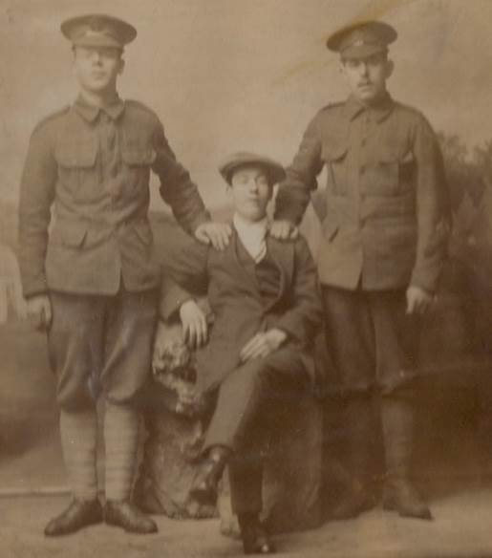

Slide 37
Battle of Coronel 1st November 1914 Able Seaman Frederick William Collett - SS/1669 Royal Navy H.M.S. "Good Hope." He was the son of Fredrick William Collett, of Worcester; husband of May A. Collett, of 41, Alfred Street, Kings Heath, Birmingham. He worked at the Moseley Road Depot. He died on the 1st November 1914 and is remembered on the Portsmouth Naval Memorial.
Able Seaman Roland Gould - SS/1383 HMS Good Hope. He worked at the Arthur Street Depot. He died on 1st November 1914 and is remembered on the Portsmouth Naval Memorial
Able Seaman Thomas Lampit Lea - 201762 H.M.S. "Good Hope." He was the brother of Mrs Jessica Thompson, of 84, Langley Road, Small Heath, Birmingham. He worked at the Highgate Road Depot. He died on the 1st November 1914 at the age of 32 and is remembered on the Portsmouth Naval Memorial.

Slide 38
The Second Battle of Ypres 22nd April to 25th May 1915 Private Thomas Lewis – 3335 1st Battalion Royal Warwickshire. Previous to the war he was employed as a conductor on the Birmingham Corporation tramways. He was the husband of Mary Jane Lewis, of Back 38, Benson Road, Winson Green, Birmingham and had three children. He worked at the Hockley Depot. He died on 25th April 1915 aged 39 and is remembered on the Ypres (Menin Gate) Memorial.

Slide 39
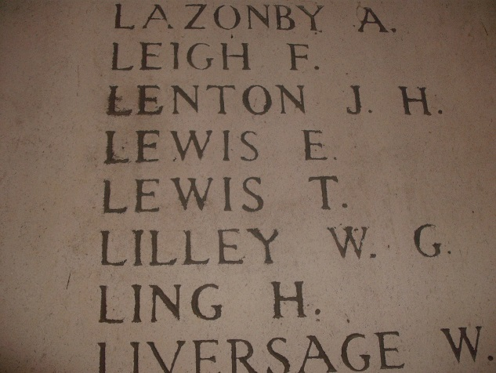

Slide 40
Lance Corporal Thomas Henry Rafferty – 7840 1st Battalion Royal Warwickshire. He is believed to be the model for Bruce Bairnsfather's cartoon character 'Old Bill'. He was the husband of Kate Rafferty of 10 Cliff Place, Baker Street, Handsworth, Birmingham. He died on the 25th April 1915 and is remembered on the Ypres (Menin Gate) Memorial Regiment. He was a motorman on the Corporation Tramways and worked at the Hockley Depot. He leaves a widow and one child.

Slide 41
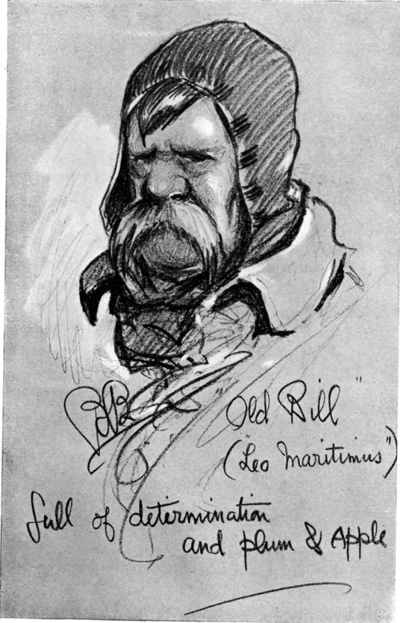
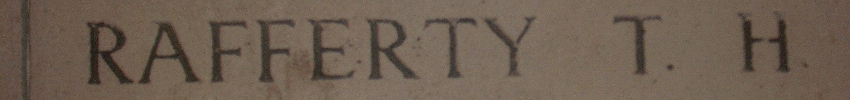
‘Old Bill’ was a character created in 1914-15 by cartoonist Bruce Bairnsfather who was also in 1st Battalion Royal Warwickshire Regiment. He used Old Bill to represent all ‘Tommies’ and drew him as an elderly, pipe-smoking soldier with a walrus moustache.

Slide 42
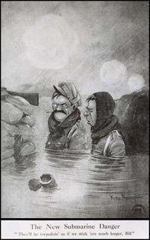
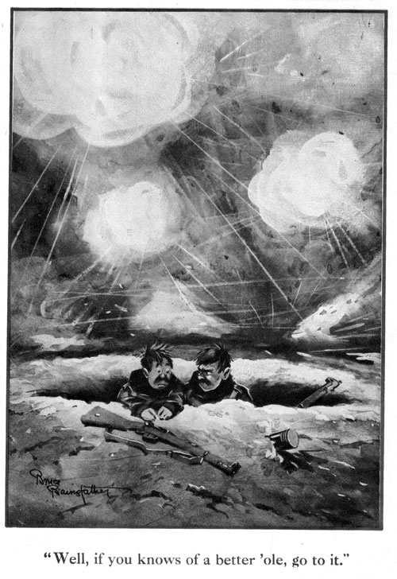

Slide 43
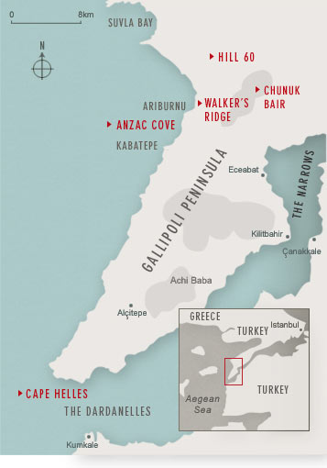
The Gallipoli Campaign Private Richard Douglas Clyde Gorman – 10705 1st Battalion Royal Dublin Fusiliers. He was the son of Mrs. Harriett Gorman, of 93, Unith Street, Hockley, Birmingham. He worked at the Miller Street Depot. He died on 30th April 1915 and is remembered on the V Beach Cemetery.

Slide 44
Private Edward Albert Tovey – 731 1st Battalion Lancashire Fusiliers. He worked at the Moseley Road Depot. He died on 13th August 1915 and is remembered on the Helles Memorial.

Slide 45
Private Albert Wright – 2534 1st/8th Battalion Worcestershire Regiment. He was the son of Mr. C. E. and Mrs. A. E. Wright, of 150, Mount Pleasant, Redditch. He worked at the Permanent Way Department. The action at Hooge 24th May 1915 to 9th August 1915. He died aged 23 on 14th July 1915 and is buried in Longuenesse (St. Omer) Souvenir Cemetery.

Slide 46
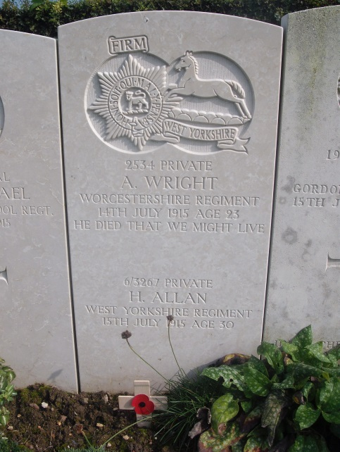

Slide 47
The Battle of Loos - 25 September - 18 October 1915 Sergeant William Ward – 9966 2nd Battalion Royal Warwickshire Regiment. He lived at 207 Warren Road, Washwood Heath. He was a motorman for Birmingham Corporation Tramways and was based at the Washwood Heath Depot. He died on 25th September 1915 and left a widow and a son. He is remembered on the Loos Memorial.

Slide 49
Private Alwyn Cox – 10186 2nd Battalion (36th Foot) Worcestershire Regiment. He was the son of Thomas Cox of Highfield Cottages, Highfield Road, Hall Green Birmingham, farm labourer, by his wife Hannah, daughter of John Mucklow. He was born in Aston Cantlow 10th June 1888 and educated there. He enlisted 28th November 1906 and served seven years with the Colours and joined the Reserves during which time he was employed as a tram conductor. He worked at the Highgate Road Depot. He was called up on the outbreak of war on August 4th 1914 and went to France on August 28th 1914. He died of wounds in Rouen Hospital on 12th October 1915 from wounds received in action at the Battle of Loos. He is buried in Rouen Cemetery.

Slide 50
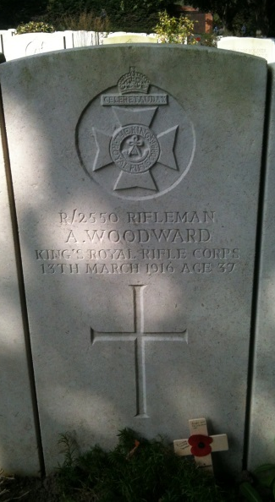
Rifleman Albert Woodward - R/2550 10th Battalion King's Royal Rifle Corps. He was the husband of Clara Wheatley (formerly Woodward), of 1/122, Latimer Street, Birmingham. He worked at the Washwood Heath Depot. He died aged 37 on 13th March 1916 and is buried in the Essex Farm Cemetery.

Slide 51
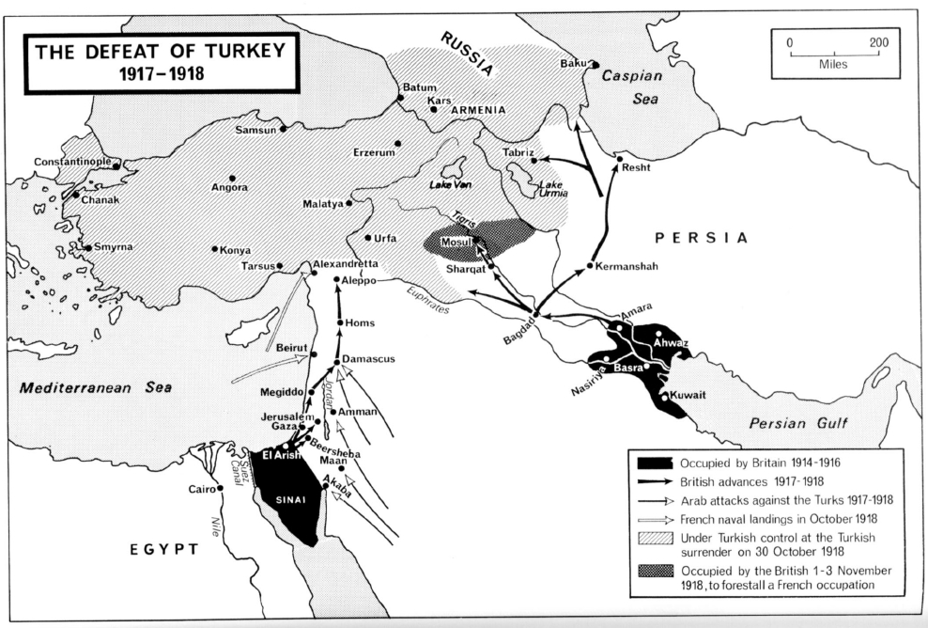

Slide 52
The Mesopotamia Campaign Private Harry Bunce – 8848 ‘A’ Company 9th Battalion Royal Warwickshire Regiment. He was the son of Thomas and Annie Bunce, of 87, Coldbath Road, Billesley and the husband of Rose Helena Bunce, of 80, Coldbath Road, Billesley, Kings Heath, Birmingham. They had three children. He worked at the Permanent Way Department. He enlisted in October 1914. He died in Mesopotamia on 28th June 1916 aged 24 and is buried in the Amara War Cemetery.

Slide 53
The Battle of the Somme - 1st July – 18th November 1916 Private Sidney Graham Arnold – 305435 1st/8th Battalion Royal Warwickshire Regiment. He was the husband Lilian Florence Arnold, of 2, Chesterton Road, Sparkbrook, Birmingham. He worked at the Highgate Road Depot. He died on 1st July 1916 aged 26 and is buried in the Serre Road Cemetery Number 1

Slide 54
Private Frederick Austin – 4264 1st/8th Battalion Royal Warwickshire Regiment. He worked at the Arthur Street Depot. He died on 1st July 1916 and is buried in the Euston Road Cemetery, Colincamps
Sergeant George Howard Broadway – 305168 1st/8th Battalion Royal Warwickshire Regiment. He was the son of George Henry and Elizabeth Broadway and husband of Mabel Emma Griffiths (formerly Broadway), of 1, Crescent Avenue, Quick Road, Handsworth, Birmingham. He worked at the Miller Street Depot. He died on 1st July 1916 aged 26 and is remembered on the Thiepval Memorial.
Private Percival Arthur Davis – 2468 1st/8th Battalion Royal Warwickshire Regiment. He was the youngest son of Sarah Jane Davies, and the late James Davies of 10 Newhall Street. He was a conductor on Birmingham Corporation trams based at Miller Street and Perry Barr Depots. He died aged 22 on the 1st July 1916 and is remembered on the Thiepval Memorial.

Slide 55
Private Robert Percy Davis – 305434 1st/8th Royal Warwickshire Regiment. He worked at the Moseley Road Depot. He died on 1st July 1916 and is remembered on the Thiepval Memorial.
Private Alfred Walter Gray – 305538 1st/8th Royal Warwickshire Regiment (2908). He was the son of Walter Gray, of 177, Aston Lane, Handsworth and husband of Ethel Gray, of 1, London Road, Handsworth, Birmingham. He worked at the Miller Street Depot. He died on 1st July 1916 aged 27and is remembered on the Thiepval Memorial.
Private Arthur William Knighton – 2664 1st/8th Royal Warwickshire Regiment who died on 1st July 1916 aged 25. He was the son of A. W. and Elizabeth Knighton, of 186, Pitsford Street, Hockley, Birmingham and husband of Edith Lee (formerly Knighton), of 238, Windsor Street, Ashted, Birmingham. He worked at the Miller Street Depot. He is remembered on the Thiepval Memorial.

Slide 56
Private Charles Mann – 305833 11th Platoon, ‘C’ Company 1st/8th Battalion Royal Warwickshire Regiment (3210). He was the son of Harry and Maria Mann. He lived at 263 Balsall Heath Road, Birmingham. Before enlistment he was a conductor for Birmingham Corporation trams and was well-known on the Moseley Road route being station at the Moseley depot. The first picture shows him in his conductor’s outfit. He died on 1st July 1916 aged 24 and is buried in the Serre Road Cemetery.

Slide 58
Private Arthur Maskell – 305554 1st/8th Battalion Royal Warwickshire Regiment (2943). He died on 1st July 1916 aged 34. He was the husband of Charlotte Prudence Maskell, of 75, Wellhead Lane, Perry Barr, Birmingham. He worked at the Miller Street Depot. He is remembered on the Thiepval Memorial
Private Harry Mavity – 3382 1st/8th Battalion Royal Warwickshire Regiment. He lived at 59 Cheapside, Birmingham. Before enlisting he worked Birmingham Coporation Tramway Company, Arthur Street Depot, Small Heath. He died on 1st July 1916 leaving a widow and one child and is remembered on the Thiepval Memorial
Private Harold Edward Phibbs – 305737 1st/8th Battalion Royal Warwickshire Regiment. He was the son of Edward and the late Eliza Phibbs of 80 Abbotsford Road, Sparkbrook. He worked at the Highgate Road Depot. He died on 01/07/1916 aged 23 and is remembered on the Theipval Memorial

Slide 59
Corporal Arthur A. Plant – 2713 1st/8th Battalion Royal Warwickshire Regiment. He was the eldest son of Smith Plant, of 1, Coldbath Road, Billesley, Birmingham, and the late Sarah Ann Plant. He was a conductor on the Stoney Lane tram route and worked at the Highgate Road Depot. His elder brother Sergeant Smith Plant was wounded on the same day. His two brothers, Sergeant Will Plant and Rifleman George Plant, were in the King’s Royal Rifles. He died on the 1st July 1916 and is remembered on the Thiepval Memorial.

Slide 60
Private George Powell – 2709 1st/8th Royal Warwickshire Regiment. He worked at the Arthur Street Depot. He died on 1st July 1916 and is remembered on the Thiepval Memorial.
Sergeant Alfred Sheppard - 305845 1st/8th Battalion Royal Warwickshire Regiment. He was the son of Mr and Mrs T. Sheppard of 5 Waterloo Road, Kings Heath. He worked at the Moseley Road Depot. He died on 1st July 1916 and is remembered on the Thiepval Memorial.
Private Frederick Sheppard – 305892 1st/8th Battalion Royal Warwickshire Regiment. He was the grandson of Mr and Mrs T. Sheppard of 5 Waterloo Road, Kings Heath. He worked at the Moseley Road Depot. He died on 1st July 1916 and is remembered on Thiepval Memorial.

Slide 62
Private Stephen Henry Squires – 305449 1st/8th Royal Warwickshire Regiment. He was a driver on the Lozells route for Birmingham Corporation trams, Miller Street and Witton Depots. His wife was Mrs L. Squires 236 Albert Road, Handsworth. He died on the 1st July 1916 and is remembered on the Thiepval Memorial.
Sergeant Percy Alfred Davies – 11791 1st Battalion Hampshire Regiment. He lived at 44 Ellen Street, Brookfields, Birmingham and was married with one child. Before the war he worked as a motorman at the Roseberry Street depot. He was a survivor of the Royal Edward, sunk on 13th August 1915. He died on 1st July 1916 and is remembered on the Thiepval Memorial.
Private Charles H. (William) Pouncey – 18744 11th Battalion Royal Inniskilling Fusiliers. He worked in the Overhead Department. He died on 1st July 1916 and is buried in the Serre Road Cemetery. One of the only divisions to reach their objective.
Private Harry G. Upton – 16343 10th Battalion West Yorkshire Regiment (Prince of Wales's Own) who died on 1st July 1916. He worked at the Hockley Depot. He is remembered on the Dantzig Alley British Cemetery, Mametz

Slide 63
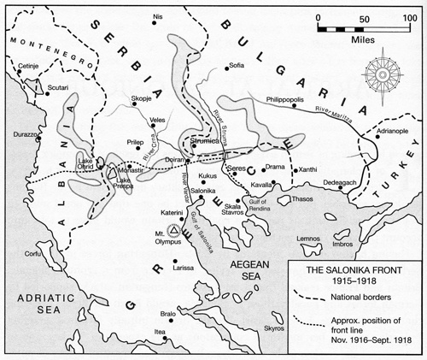

Slide 64
The Salonika Campaign 1915 – 1918 Private William Hughes – 16062 11th Battalion Worcestershire Regiment. He was the son of Mr. and Mrs. Walter Hughes, of 19, Poplar Avenue, King's Heath, Birmingham and husband of Wilhelmina Gertrude Hughes, of 38, Alfred Rd., Sparkhill, Birmingham He worked at the Highgate Road Depot. He died aged 26 on 12th October 1916. He is remembered on the Doiran Memorial.
Sergeant Henry Bannister – 13367 12th Battalion Hampshire Regiment (formerly 16305 Worcestershire Regiment). He was the son of Henry and Sarah J. Bannister, of 13, Montgomery Street, Sparkbrook, Birmingham and husband of Millicent A. Bannister, of 85, Avondale Road, Sparkhill, Birmingham. He had two children He was born in Wolverhampton. Before the war he was a motorman employed by Birmingham Tramways Department at the Highgate Road Depot. He joined the colours in September 1914 and died between 24th and 25th April 1917 aged 32. He is buried in the Doiran Military Cemetery.
Driver Albert James Anderton – 118790 "A" Battery 114th Brigade Royal Field Artillery. He was one of six sons of Mr and Mrs John Anderton, of 2, Hope Place, Bordesley Green Road, Bordesley Green, Birmingham on active service. He was the husband of and husband of Annie Anderton, of 3 Cremore Avenue, Terry Road, Saltley, Birmingham and had three children. He worked for Birmingham Corporation Tramways at the Perry Barr and Witton Depots. He was one of the old ‘Contemptibles’. He was involved in the Salonika Campaign. He died of influenza on 3rd October 1918 aged 33 and is buried in the Kirechkoi-Hortakoi Military Cemetery.

Slide 65
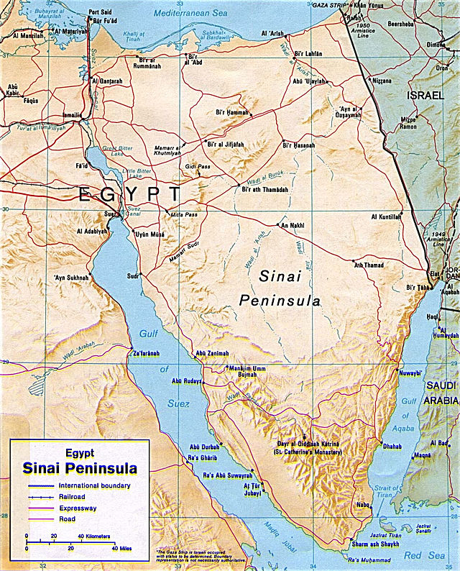
The Sinai and Palestine Campaign January 1915 – October 1918

Slide 66
Private Owen J. Morris – 325683 1st Queen's Own Worcestershire Hussars (Worcester Yeomanry). He was the son of Joseph and Ann Morris, of Mounton, Templeton, Pembrokeshire. He worked at the Tennant Street Depot. He died aged 32 on 14th May 1917 and is buried in the Deir El Belah War Cemetery.

Slide 67
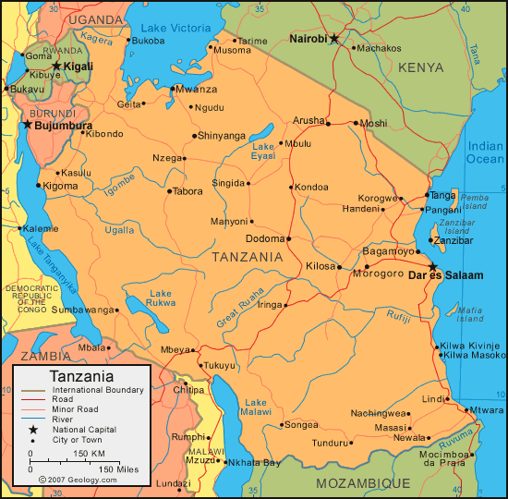
The war in Africa
General Paul von Lettow-Vorbeck,

Slide 68
Private Edwin Fenn – 202106 5th Battalion Royal Warwickshire Regiment. He was the son of Henry and Ellen Fenn, of Birmingham and husband of Harriet Ann Fenn, of 4, The Elms, Marrowdy Street, Birmingham, England. He worked at the Roseberry Street Depot. He died on 31st May 1917 aged 27 and is buried in the Dar Es Salaam War

Slide 69
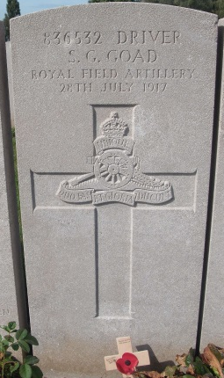
The Third Battle of Ypres 31st July 1917 – 10th November 1917 Driver Sidney George Goad – 836532 ''C'' Battery 71st Brigade Royal Field Artillery. He worked at the Miller Street Depot. He died on 28th July 1917 and is buried in the Lijssenthoek Military Cemetery.

Slide 70
Captain James Grimshaw Cunliffe – 18th Battalion Manchester Regiment. Military Cross. ‘For conspicuous gallantry and devotion to duty. When commanding a company in the front line he opened rapid fire on a hostile patrol who were attempting to enter the trench, and then led his party over the parapet in full view of the enemy, by his personal courage and fearless example dispersing them with and taking several prisoners.’

Slide 71
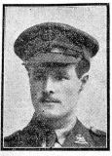
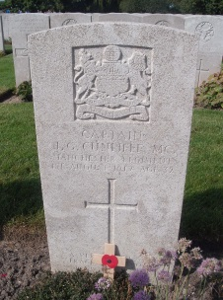
He died of wounds at Lijssenthoek Hospital on 1st August 1917 aged 31 and is buried in the Lijssenthoek Military Cemetery.

Slide 72
The First Battle of Passchendaele 12th October 1917 Private Frederick Ashby – 32216 6th Battalion Royal Berkshire Regiment (Previously Royal Warwickshire Regiment). The worked at the Kyotts Lake Road Depot. He died on 12th October 1917 and is buried in the Cement House Cemetery.
Gunner William McCourty – 163326, 119th Siege Battery, Royal Garrison Artillery. He was the son of Agnes McCourty and husband of Emily McCourty, of 181 St. Andrews Road, Small Heath. He was a native of Carlisle. He worked at the Arthur Street Depot. He died on 10 December 1917 aged 29 and is remembered on the Ypres Reservoir Memorial.

Slide 73
Operation Michael 21st March – 5th April 1918 Gunner Thomas Rowley – 836433 "C" Battery 307th Brigade Royal Field Artillery. He was the son of Mr. and Mrs. Rowley, of 29, Hawkins Lane, Burton-on-Trent and the husband of Annie Rose Rowley, of 24, Scalpcliffe Road, Burton-on-Trent. He worked at the Moseley Road Depot. He died on 21st March 1918 aged 34 and is remembered on the Pozieres Memorial.
Thompson - R/5383 16th Battalion King's Royal Rifle Corps. He worked at the Permanent Way Department. He died on 21st March 1918 and is buried in the Tyne Cot Cemetery.
Captain Joseph Alfred Coley – 5th Battalion, attached to the 4th Battalion Royal Fusiliers. He was the only son of Alfred William and Catherine Lavinia Coley, of 124, Pretoria Road, Bordesley Green, Birmingham. Before the war he was employed at the head office of the Birmingham Corporation Tramways Department. He enlisted in one of the City Battalions and was wounded in July 1916. In August 1917 he was granted a commission and was promoted to Captain in November 1917. He died on 22nd March 1918 aged 21 and is remembered on the Arras Memorial.

Slide 74
Sergeant Arthur Thomas Bradley MM – 21577 128th Heavy Battery Royal Garrison Artillery. He was the husband of Lilian Edith Kate Bradley, of 86, Wills Street, Smethwick, Staffs. He worked at the Hockley Depot. He died on 22nd August 1918 aged 30 and is buried in the Heath Cemetery, Harbonnieres.

Slide 75
Lance Corporal Walter Charles Richardson – 203493 2nd/8th Worcestershire Regiment. He was the son of Thomas and Elizabeth Richardson, of Birmingham and husband of Mary Elizabeth Richardson, of 1740, Pershore Road, Cotteridge, Birmingham. He worked at the Moseley Road Depot. He died on 19th October 1918 aged 26. He is buried in the Berlin South-Western Cemetery

Slide 76

Private Edward Stone

Slide 77
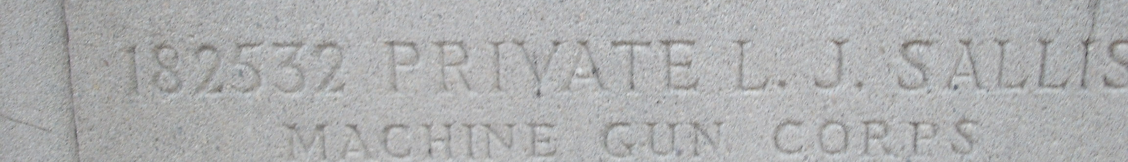
Private Leonard James Sallis – 182532 Machine Gun Corps (Infantry). He was the son of Mr. and Mrs. C. Sallis, husband of Elizabeth Sallis, of 7, Vine Avenue, Runcorn Road, Balsall Heath, Birmingham. Born at Pamington, Ashchurch. He worked at the Moseley Road Depot. He died on 4th November 1918 aged 32. He is buried in Brandwood End Cemetery, Birmingham.

Slide 78
